Slide 1

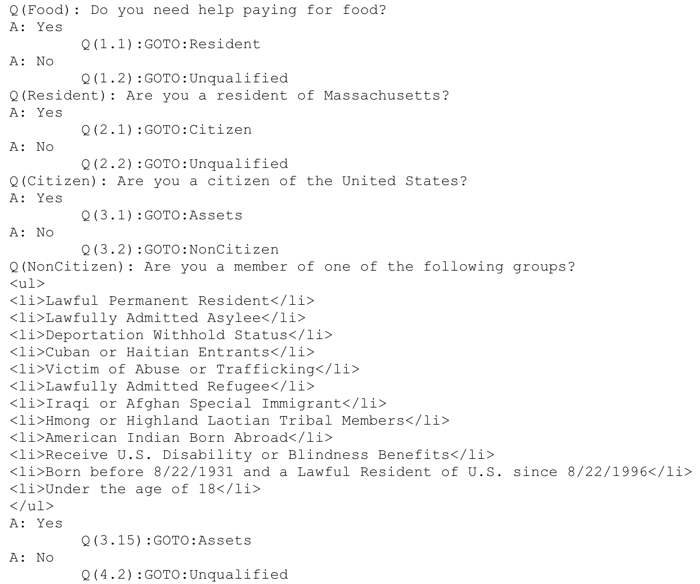
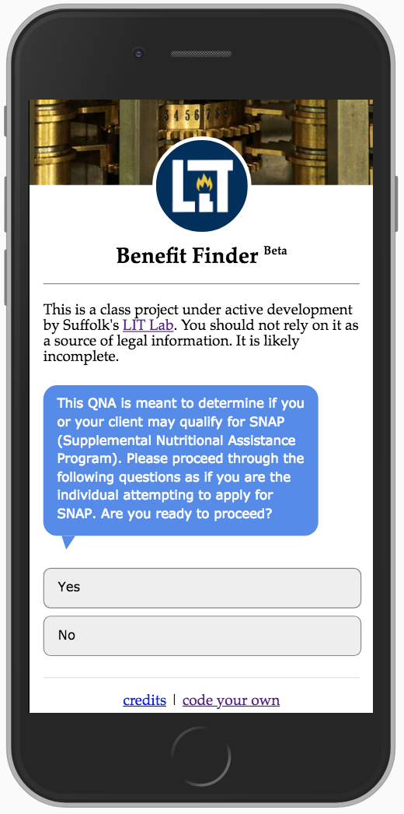
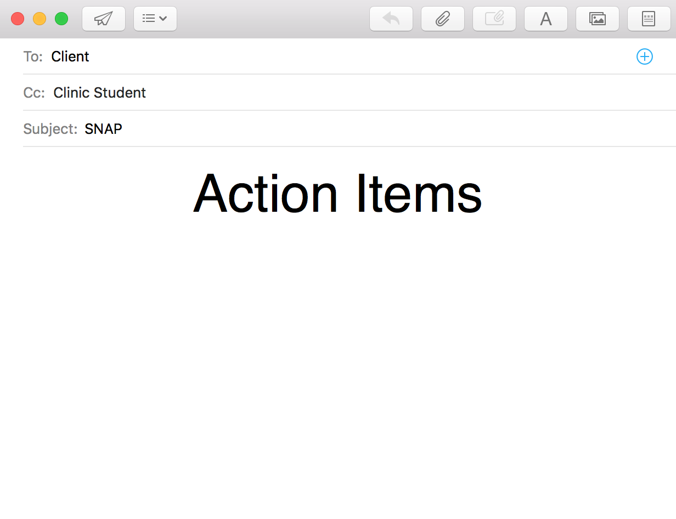
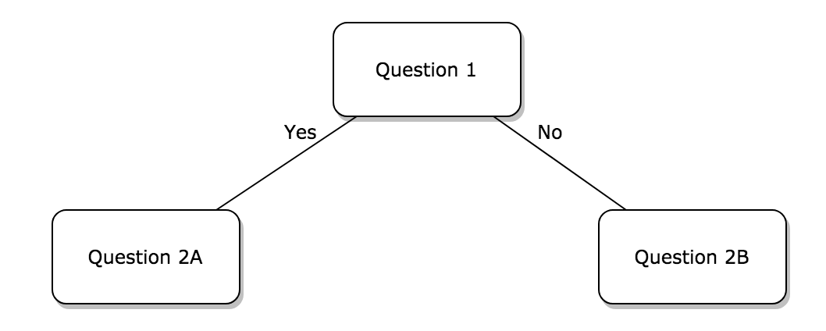
Navigating the World of Public Benefits
Michael R. DiFilippo & Alessandra Ambrogio
Problem
Methodology
Solution
Future
There are several public benefit programs with varying eligibility requirements.
Clinic students are new practitioners with little knowledge of the available programs.
The clinics primarily serve indigent clients, who can benefit greatly from public benefit programs.
Moreover, determining eligibility can take several hours.
How do we deliver the information to new practitioners quickly in the most accessible method possible?
First, we researched the eligibility requirements of the available programs in MA.
Second, we created flowcharts/decision trees for three of the most prominent benefits to determine a client’s eligibility.
Third, we asked expert attorneys in the Family Advocacy Clinic and Health Law Clinic at Suffolk Law to provide feedback.
The next step was to decide how best to deliver the information.
We decided to use QnA Markup to create a Benefit Finder, because it resembles an iMessage conversation.
The tool gathers demographic information to determine client eligibility.
In sum, it is an interactive flowchart/decision tree.
It outputs an email with action items regarding how to apply if the user or client might be eligible.
Expand – Add more benefit programs to the tool.
Improve – Continue to gather user-feedback and fine-tune the tool.
Sustain – Develop a plan so new clinic students can expand, update, and maintain the tool.
Share – Make it accessible to the public (currently, it is an internal tool for the clinics).

